Slide 1


Finding Missing People
Using Deep Learning

Slide 2


Slide 3
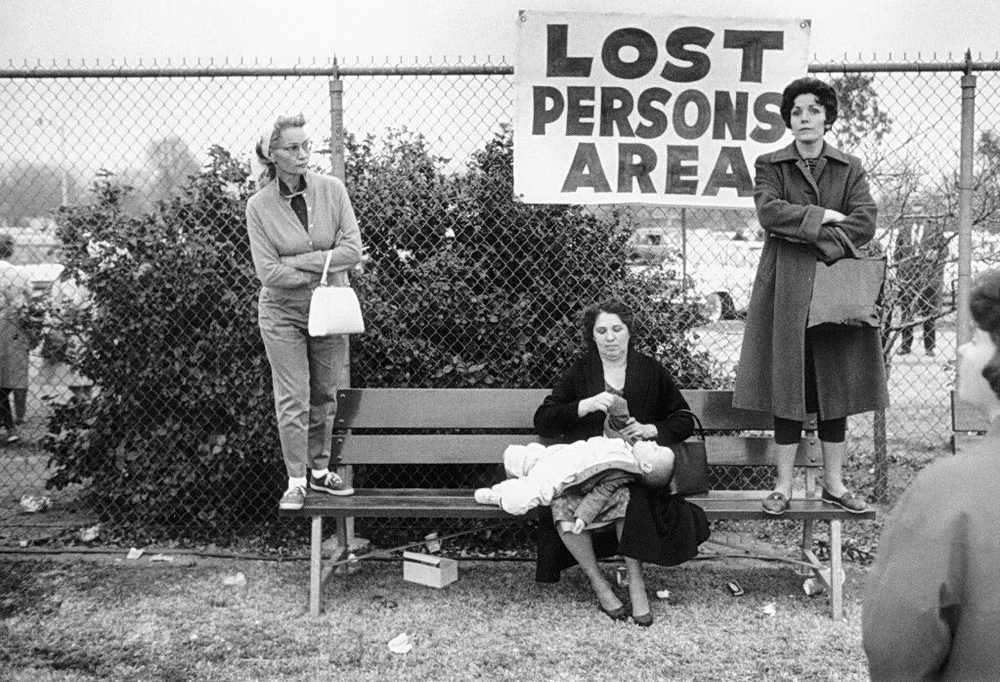

Slide 4


Six in 10 people with dementia will wander.
A person with Alzheimer's may not remember his or her name or address

Slide 5

Did you know?
Someone is reported missing every 90 seconds in the UK

Slide 6
Did you know?
How many people go missing each year?

Slide 7
Did you know?
For example in the UK
186,000 people reported missing nearly
100,000 are adults
86,000 are children

Slide 8


Slide 9

Face Recognition

Slide 10
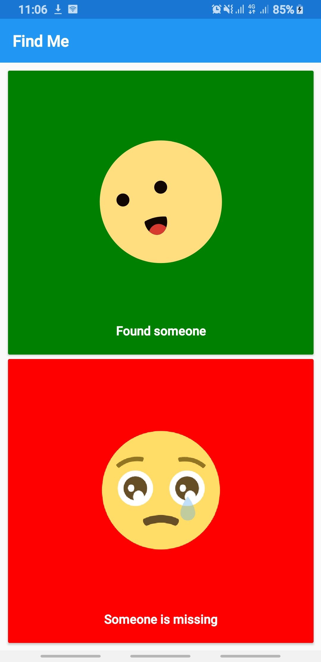
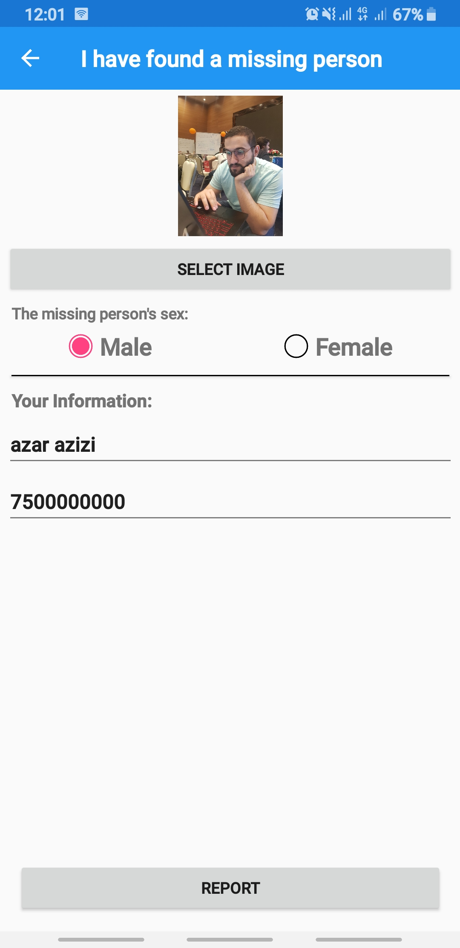
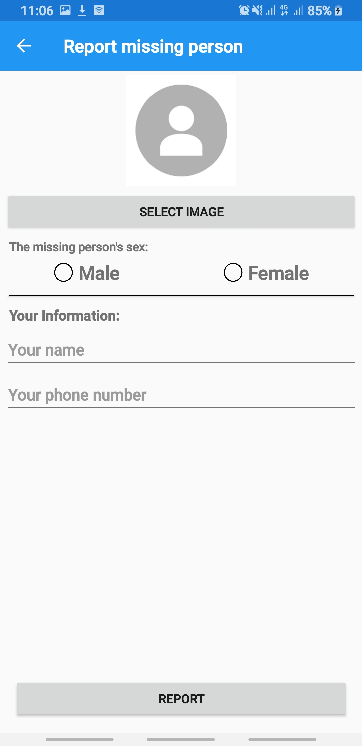
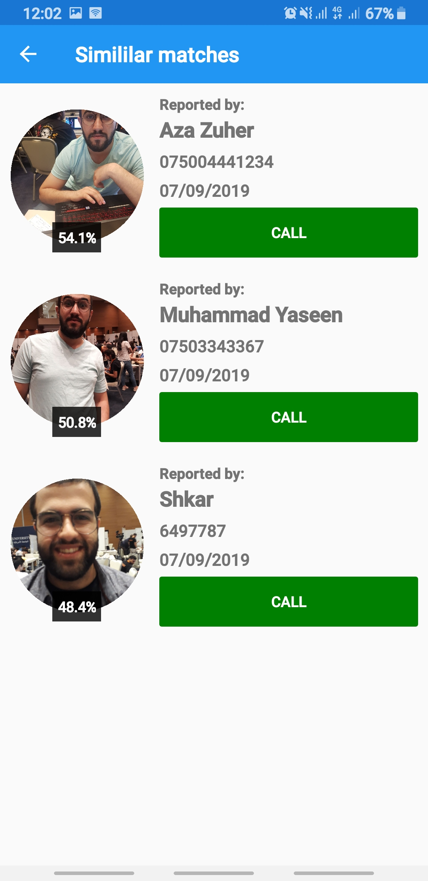
1
2
3
4

Slide 11


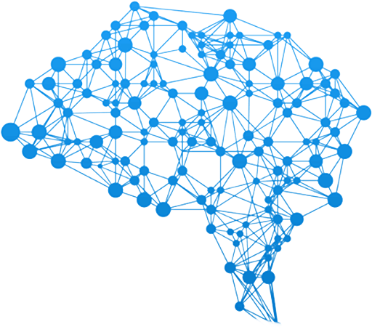





Slide 12
BUSINESS MODEL
Free to use
Potential to be funded by Government, NGOs
The Data can be used for further research purposes
Improve available face data sets

Slide 13




Muhammad Azeez
Full-Stack Dev
Rawand Farhad
Full-Stack Dev
Rasti Khalid
IT Undergrad
Shkar Taib
R&D Engineer

